Slide 1
Welcome
Department of Mathematics
University of Rajshahi
Today, We are going to create a rectangle using asterisks in C

Slide 2

Represent By:-
Name : Protiva Ray Kabbo
Roll : 2112021106
Session : 2020-21
Represent To:-
Professor Dr. Gour Chandra Paul
Department of Mathematics
University of Rajshahi
Phone: 01712187595

Slide 3
Name and Id of Our Team Members
Protiva Ray Kabbo
Mst. Tasnia Ferdous
Abdullah
2112021106
2112221116
2110821126
Md.Monirul Islam
Md.Liaqat ali
Umme Mahfuja
2111021136
2110621146
******
Md.Atiqul Islam Santo
Shakir Syeam
Md Jayid Hasan
2110321166
2110521176
2110621186
Dhananjoy Chandra Das
Momino Shikder Meem
2110221206
2112221216

Slide 4
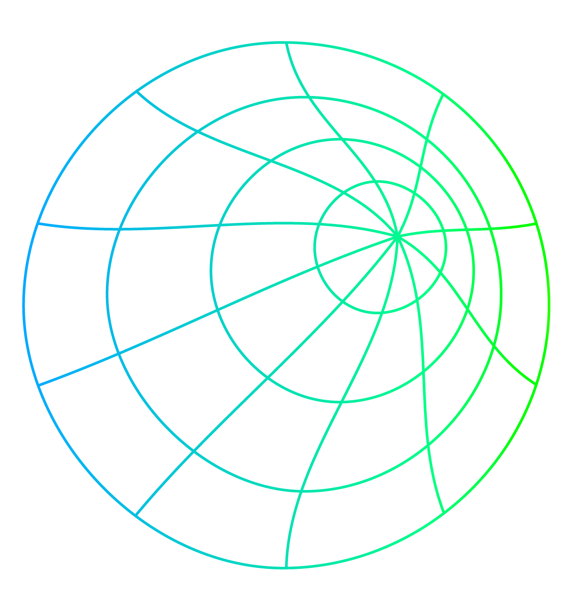
TABLE OF CONTENTS
01
02
03
About the project
The project involves creating a program in C to generate a rectangle shape using asterisks based on user input for width and height.
Major Requirement
C Programing Language
User Interaction
Rectangle Generation
Output Display
Project goals
The project’s primary goal is to develop a program that allows users to define the dimensions of a rectangle and generates a visual representation of the rectangle using asterisks.

Slide 5
INTRODUCTION of C
C is a powerful and widely-used programming language known for its efficiency and versatility. It is a procedural language with a simple syntax, offering low-level memory access and portability across different platforms.

Slide 6
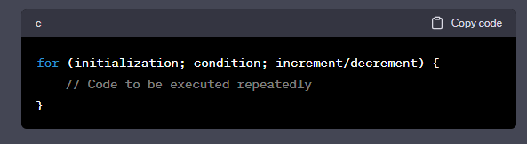
01
What is For Loop in C
A for loop in C is a control structure that repeatedly executes a block of code based on a specified condition, initialization, and increment or decrement, allowing efficient iteration and control over the loop execution flow.

Slide 7
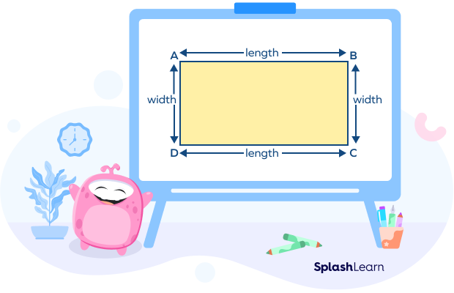

02
What is Rectangle?
A rectangle is a geometric shape with four sides and four right angles. It is characterized by having opposite sides that are equal in length.

Slide 8
Flow Chart
Algorithm
Start
STEP - 01:
Start Program
h,w
STEP - 02:
Input height h and width w
The nested loops are created to iterate over each row and column of the rectangle. The outer loop controls the rows, while the inner loop controls the columns.
Block of Statement-01
( Outer For loops Execute )
STEP - 03:
Block of Statement-02
( Nested For loops Execute )
if-else condition to determine whether to print an asterisk (*) or a space ( ).
STEP - 04:
False
If
Condition?
True
Show the Rectangle body with space
Show the Rectangle side with *
STEP - 05:
End Program
End

Slide 9
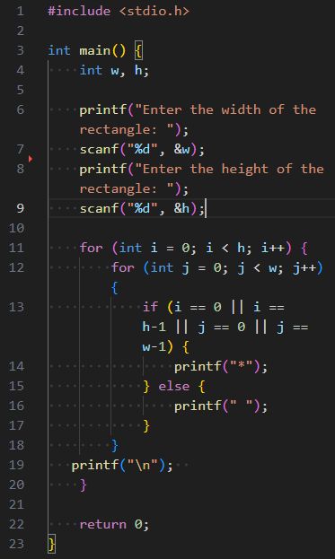





Code Explaination
Header Files
Declare variables
Get input from User
Iteration - 1
Iteration - 5
Iteration – 2,3,4
i== 0
true
i== 0
false
true
i = 4 (5th Row)
i== h-1
false
i = 0 (1st Row)
i = 1-3 ( 2nd – 4th Row)
false
j = 3
j== 0
true
j = 4
j = 3
j = 0
j = 3
j = 4
j = 0
j = 2
j = 4
j = 1
j = 1
j = 1
j = 0
j = 2
j = 2
Generate the rectangle using asterisks
false
Condition
j== w-1
true
Return from the main function

Slide 10
Description of the project content
1st Part
Input
2nd Part
Processing
3rd Part
Output
Implementation

Slide 11
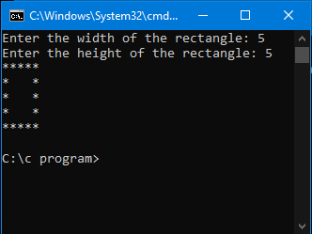
Rectangle Printing Program: Input Width and Height, Display Output
#include <stdio.h> int main() {
int w, h; printf("Enter the width of the rectangle: ");
scanf("%d", &w);
printf("Enter the height of the rectangle: ");
scanf("%d", &h); for (int i = 0; i < h; i++) {
for (int j = 0; j < w; j++) {
if (i == 0 || i == h-1 || j == 0 || j == w-1) {
printf("*");
} else {
printf(" ");
}
}
printf("\n");
} return 0;
}
Enter the width of the rectangle:
5
Enter the height of the rectangle:
5

Slide 12

Thanks
Professor Dr. Gour Chandra Paul
Department of Mathematics
University of Rajshahi
Thanks to our honorable professor Dr. Gour Chandra Paul, Team members, and presented all teams who enjoyed our presentation attentively. If we get more chances, we will develop ourselves to solve any program.
Source Of Images & defination:
Google, Wikipedia , RU Websites, freepik

